Slide 1
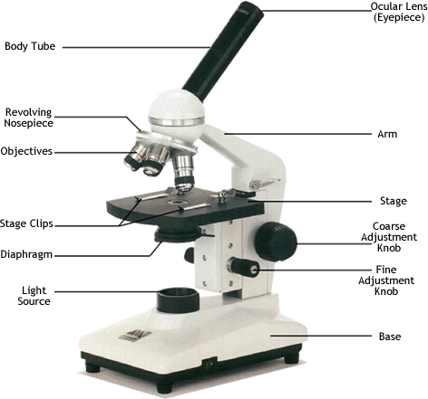
Parts of a Light Microscope

Slide 2
How to Focus on Specimen
Turn on light source on high
Turn the objective to low (4x)
Lower the objective lens so that it is close but not touching the slide
Center the image by moving the stage
Adjust the diaphragm for optimum light
Adjust focus, first with course then fine
Switch to higher power, adjust ONLY with fine focus

Slide 3
How to Use a Microscope
http://www.youtube.com/watch?v=bGBgABLEV4g

Slide 4
Field of View
The diameter of the circle of light you can see when looking through the microscope.

Slide 5
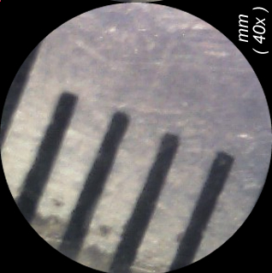
Field of View Con’t
Measured by placing a clear ruler under the objective and counting how many mm fit across the diameter
Usually measured in mm but expressed in μm

Slide 6
Field of View Con’t
Typical field of view measurements for light microscope:
Objective Lens | Total Mag. | Field of View (mm) | Field of view (μm)
4x |  | 4.5
10x |  | 1.8
40x |  | 0.45

Slide 7
Estimating Size under Microscope
Estimating the size of a specimen using field of view diameter…
Estimated Length (actual length) = Field diameter (μm)
Fit number
Fit number is the amount of times the specimen can fit across the diameter

Slide 8
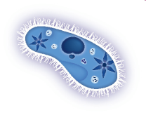
Estimating Size Con’t
What would be the fit number here?

Slide 9
Calculating Diagram Magnification
When drawing specimens viewed under the microscope it is custom to calculate the magnification of your drawing
To do this, you must first calculate estimated length of specimen under microscope.
Diagram (drawing) Magnification = Diagram size (μm)
Estimated Length of Specimen
NOTE: Measure your drawing in mm then convert to μm

Slide 10
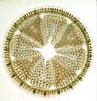
Calculating Diagram Magnification
Use this diagram to answer questions 1, 2, 3 on sheet
Total Mag = 400x

