Slide 1
Cell Surface Area and Volume

Slide 2
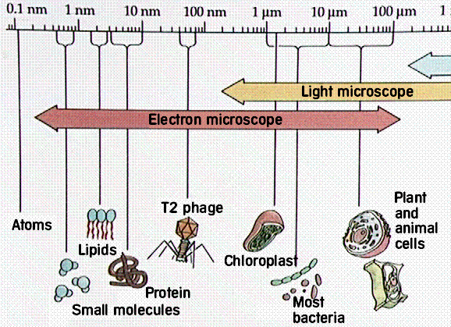
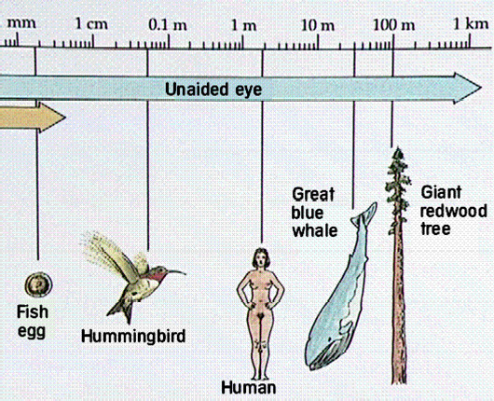
Cells are typically Small
Typical cell size

Slide 3
Why are Cells Small?
Cells must exchange nutrients & other molecules with environment.
Nutrients in and wastes out.
The cell membrane is the only way in and out of the cytoplasm.
The cell membrane has a limited surface area.
The cytoplasm has a volume to “feed” or have wastes removed.

Slide 4
Comparison of Size, Surface Area
& Volume
Cell size | Surface area (units²) |  | Volume (units³) | Ratio of SA/V
1 unit
 |  | Copy and complete this chart as we go through the following examples
2 units
3 units

Slide 5
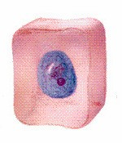
Surface area of a cell – cell membrane
Consider the above cell:
If it were a perfect square, how would you calculate surface area?
A = L x W
Each side is 1X1=1unit squared, 6 sides therefore, surface area = 6 units squared
Length equals one unit

Slide 6
Volume of a cell - cytoplasm
Distance equals one unit
Volume equals: Length x Width x Height
Thus the volume equals ?
Volume equals 1 unit cubed

Slide 7


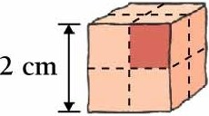
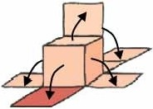





- _,_ --
- _,_ --
- _,_ - -
- - -
I
--
I
I
I
.----..-
-i- - _ ,_ - -v
- ...----,
Imagine unfolding a cube.
I I I I I
Surface area: 6
- - r - - r - -1- - -,- - -,- -
I
.. _,... --,- - -.--
---'
Volume : Ratio:
1
6:1
I I
Surface area: 24
Volume: 8
Ratio: 3:1
© BrookslCole -Thomson Leaming
•
•
•
•
••
• •
•

Slide 8
Comparison of Size, Surface Area
& Volume
Cell size | Surface area (units²) | Volume (units³) | Ratio of SA/V
1 unit | 6 | 1 | 6:1
2 units | 24 | 8 | 3:1
3 units | 54 | 27 | 2:1

Slide 9
Conclusion:
As cell size increases ratio of surface area to volume decreases.
Therefore, the rate of diffusion slows down….
…..thus a cell cannot get rid of wastes fast enough or get nutrients fast enough
. . . so it will either be poisoned by its wastes or starve.

Slide 10
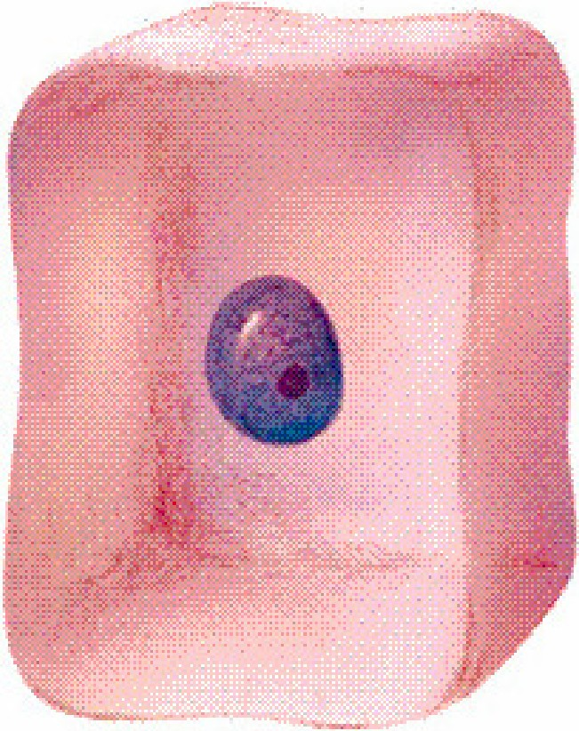
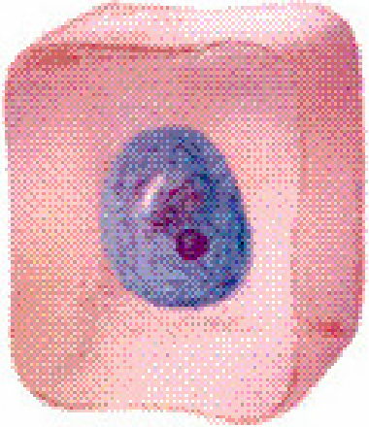
Cell size
small cell­
more surface area
per volume
large cell­
less surface area
per volume

Slide 11
Larger Cells
Smaller surface to volume ratio
Larger cells have less membrane
Larger cells have hard time obtaining nutrients, getting rid of wastes, and regulating internal environment
Once a cell reaches a certain size, it cannot grow any larger so it must divide and form 2 cells
Cell division is called mitosis

Slide 12
Comparison of Size, Surface Area
& Volume
Length (cm) (L) | Surface area (cm²) (6 X L²) | Volume (cm³) (L³) | Ratio of SA/V
2
4
8

