Slide 1
Classification

Slide 2
The Classification Game!!
Divide into groups of 3 or 4
In the following few slides, you will find
14 different organisms, each of them labeled
with a letter. In your groups, write down
two main classification (example red/green).
Then place the corresponding letters under
the correct classification.

Slide 3
For Example
These organisms have been
classified by their color.
Green
Red

Slide 4
ARE
YOU
READY!

Slide 6
One Possible Solution
Plants
Animals
????

Slide 7
Did You Have Problems??
There were actually several different ways to go
about classifying these 14 organisms. You might
have done color, shape, size, number of legs… the
possibilities are endless. You might have encountered
one or two that really did not fit into either of your
two classifications, what should you do when this
happens? Make a new classification of course! And
this is what scientist have done as well through the
years.

Slide 8
Species of Organisms
There are 13 billion known species of organisms
This is only 5% of all organisms that ever lived!!!!!
New organisms are still being found and identified

Slide 9
What is Classification?
Classification is the arrangement of organisms into orderly groups based on their similarities
Classification is also known as taxonomy
Taxonomists are scientists that identify & name organisms

Slide 10

Benefits of Classifying
Accurately & uniformly names organisms
Prevents misnomers such as starfish & jellyfish that aren't really fish
Uses same language (Latin or some Greek) for all names
Sea”horse”??

Slide 11
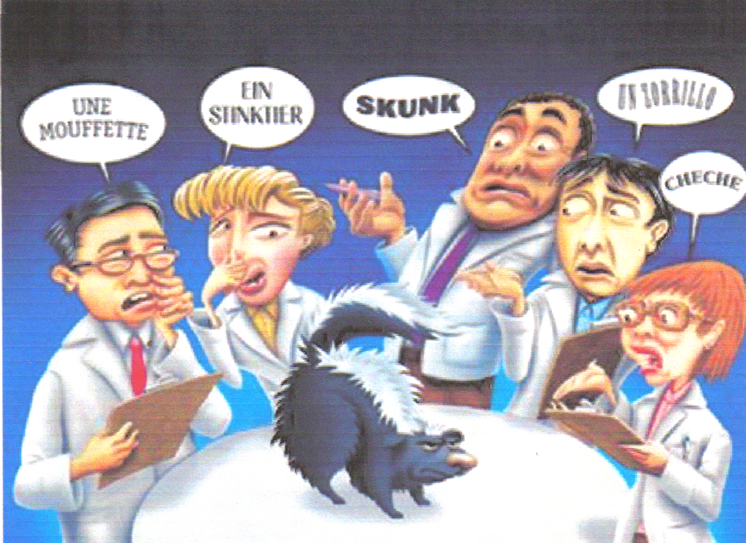
Confusion in Using Different Languages for Names

Slide 12
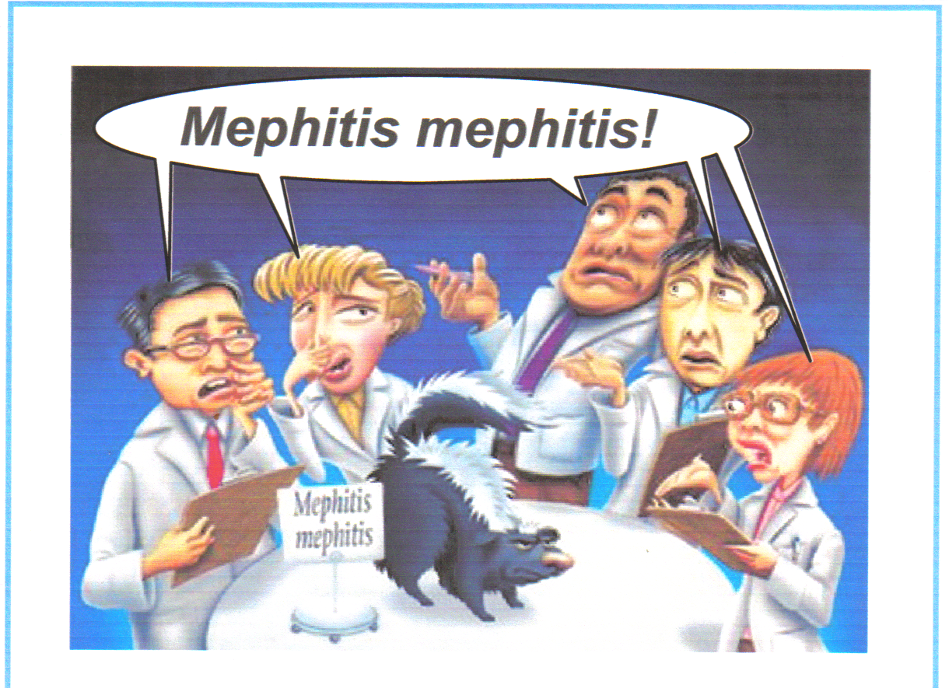
Latin Names are Understood by all Taxonomists

Slide 13
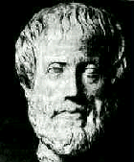
Early Taxonomists
2000 years ago, Aristotle was the first taxonomist
Aristotle divided organisms into plants & animals
He subdivided them by their habitat ---land, sea, or air dwellers

Slide 14
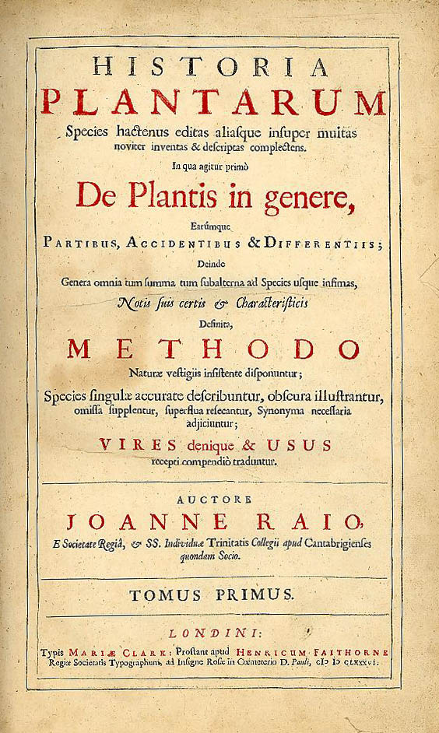
Early Taxonomists
John Ray, a botanist, was the first to use Latin for naming
His names were very long descriptions telling everything about the plant

Slide 15
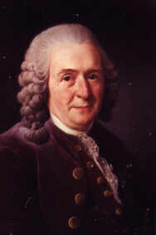
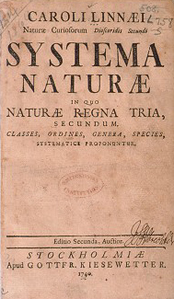
Carolus Linnaeus
1707 – 1778
18th century taxonomist
Classified organisms by their structure
Developed naming system still used today

Slide 16
Carolus Linnaeus
Called the “Father of Taxonomy”
Developed the modern system of naming known as binomial nomenclature
Two-word name (Genus & species)

Slide 17
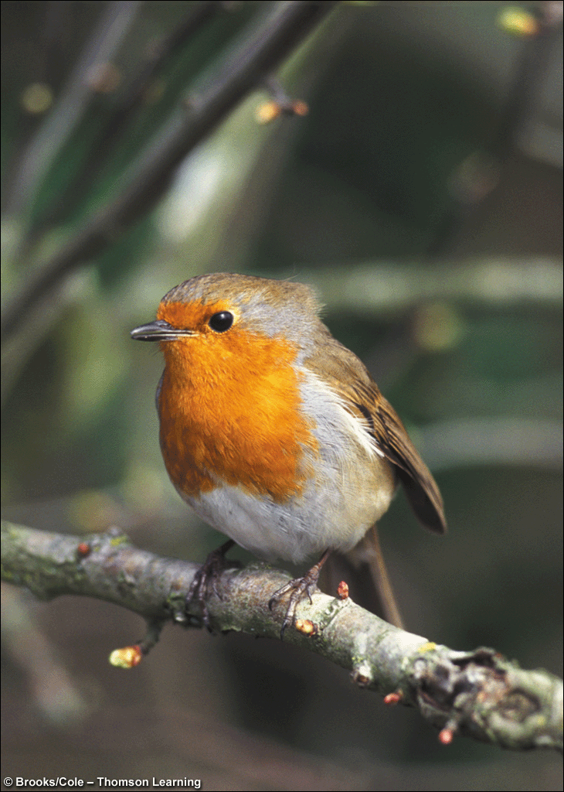
Standardized Naming
Binomial nomenclature used
Genus species
Latin or Greek
Italicized in print
Capitalize genus, but NOT species
Underline when writing
Turdus migratorius
American Robin

Slide 18
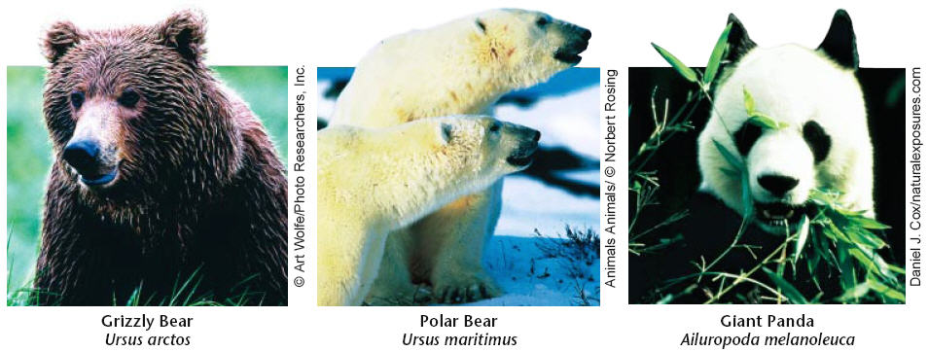
Binomial Nomenclature
Which TWO are more closely related?

Slide 19
Rules for Naming Organisms
The International Code for Binomial Nomenclature contains the rules for naming organisms
All names must be approved by International Naming Congresses (International Zoological Congress)
This prevents duplicated names

Slide 20
Classification Groups
Taxon ( taxa-plural) is a category into which related organisms are placed
There is a hierarchy of groups (taxa) from broadest to most specific
Domain, Kingdom, Phylum, Class, Order, Family, Genus, species

Slide 21
Hierarchy-Taxonomic Groups
Domain
Kingdom
Phylum (Division – used for plants)
Class
Order
Family
Genus
Species
BROADEST TAXON
Most Specific
Notes:
Genus and species are the two names used to identify specific organisms in the binomial system of classification. Division is used for plants.

Slide 22
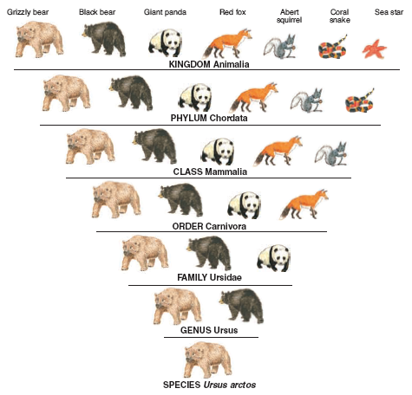
Dumb
King
Phillip
Came
Over
For
Gooseberry
Soup!

Slide 23
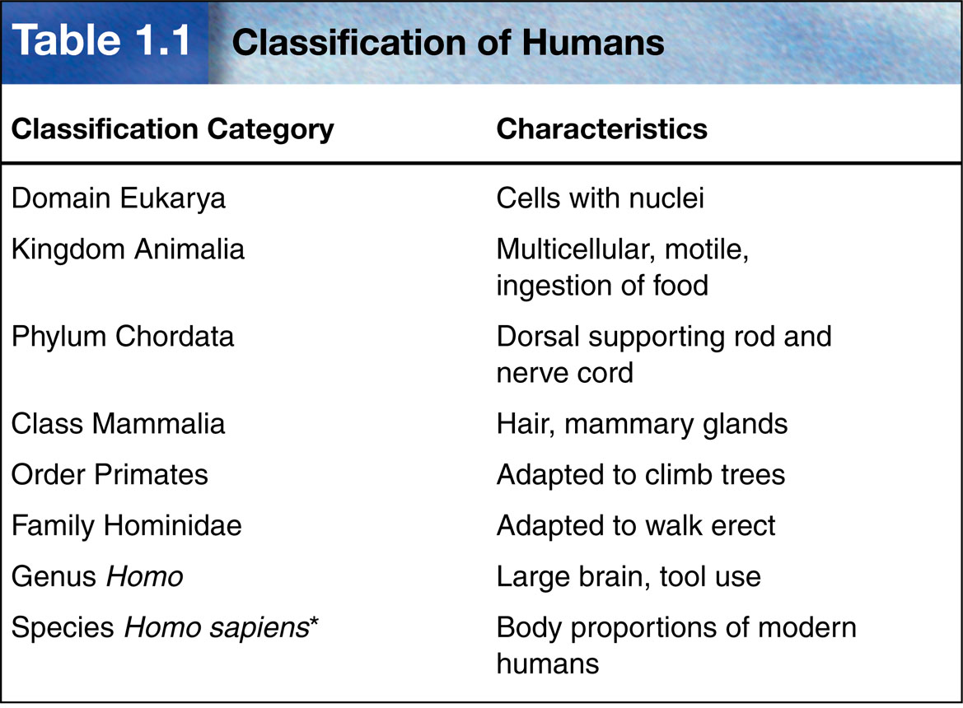

Slide 24
Domains
Broadest, most inclusive taxon
Three domains
Archaea and Bacteria are unicellular prokaryotes (no nucleus or membrane-bound organelles)
Eukarya are more complex and have a nucleus and membrane-bound organelles

Slide 25
ARCHAEA
Kingdom - ARCHAEBACTERIA
Probably the 1st cells to evolve
Live in HARSH environments
Found in:
  Sewage Treatment Plants (Methanogens)
  Thermal or Volcanic Vents (Thermophiles)
  Hot Springs or Geysers that are acid
  Very salty water (Dead Sea; Great Salt Lake) - Halophiles

Slide 26
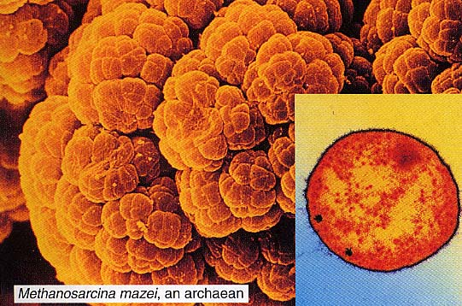
ARCHAEAN

Slide 27
BACTERIA
Kingdom - EUBACTERIA
Some may cause DISEASE
Found in ALL HABITATS except harsh ones
Important decomposers for environment
Commercially important in making cottage cheese, yogurt, buttermilk, etc.

Slide 28
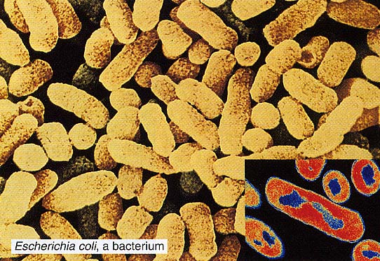
Live in the intestines of animals

Slide 29
Domain Eukarya is Divided into Kingdoms
Protista (protozoans, algae…)
Fungi (mushrooms, yeasts …)
Plantae (multicellular plants)
Animalia (multicellular animals)

Slide 30
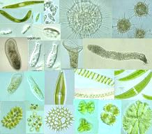
Protista
Most are unicellular
Some are multicellular
Some are autotrophic, while others are heterotrophic
Aquatic

Slide 31
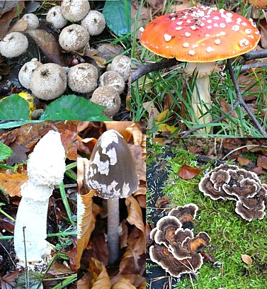
Fungi
Multicellular, except yeast
Absorptive heterotrophs (digest food outside their body & then absorb it)
Cell walls made of chitin

Slide 32
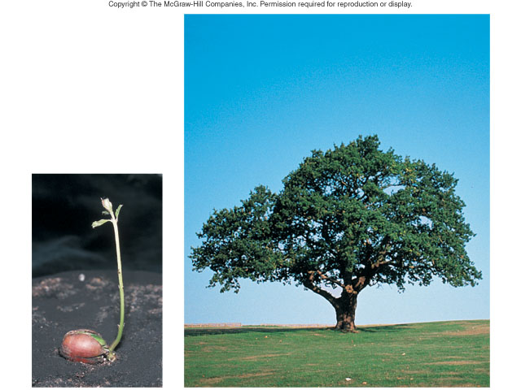
Plantae
Multicellular
Autotrophic
Absorb sunlight to make glucose – Photosynthesis
Cell walls made of cellulose
Notes:
Growth, with increases in size and number of cells, is part of development.
Development involves many stages from conception until death.

Slide 33
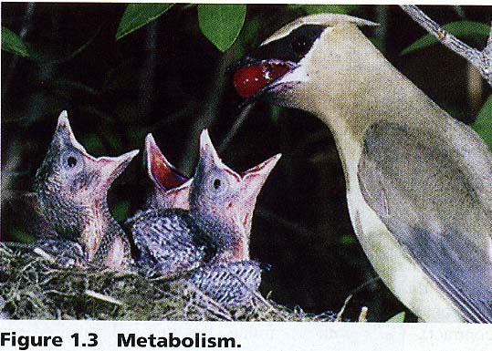
Animalia
Multicellular
Ingestive heterotrophs (consume food & digest it inside their bodies)
Feed on plants or animals

Slide 34
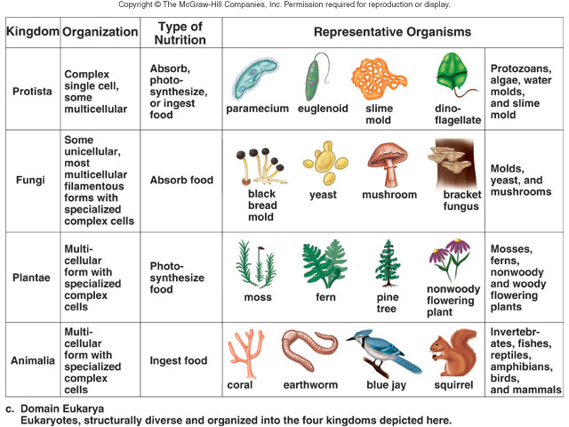

Slide 35
Taxons
Most genera contain a number of similar species
The genus Homo is an exception (only contains modern humans)
Classification is based on evolutionary relationships

Slide 36
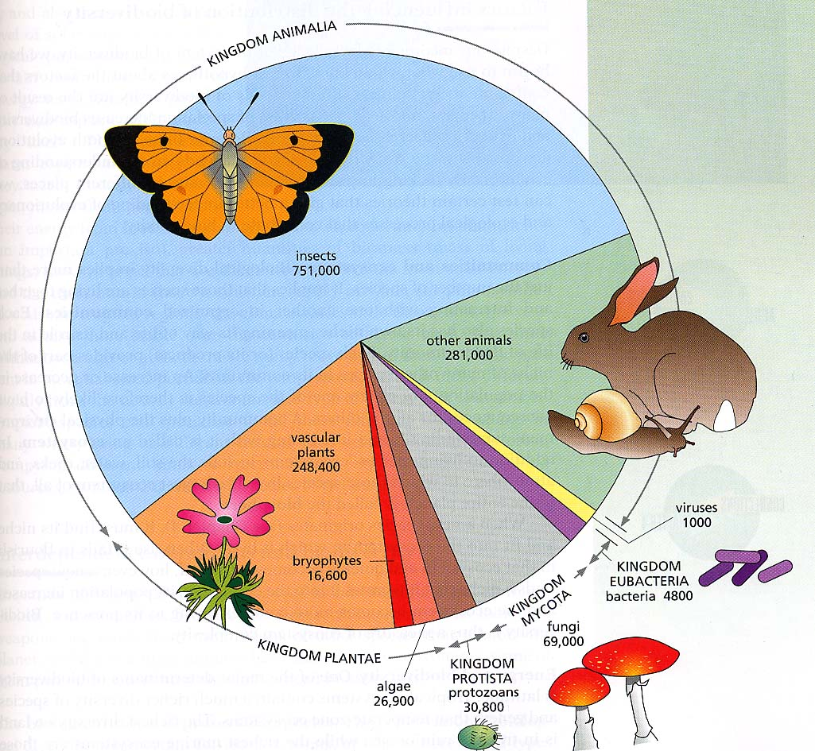

Slide 37
Basis for Modern Taxonomy
Homologous structures (same structure, different function)
Similar embryo development
Molecular Similarity in DNA, RNA, or amino acid sequence of Proteins

Slide 38
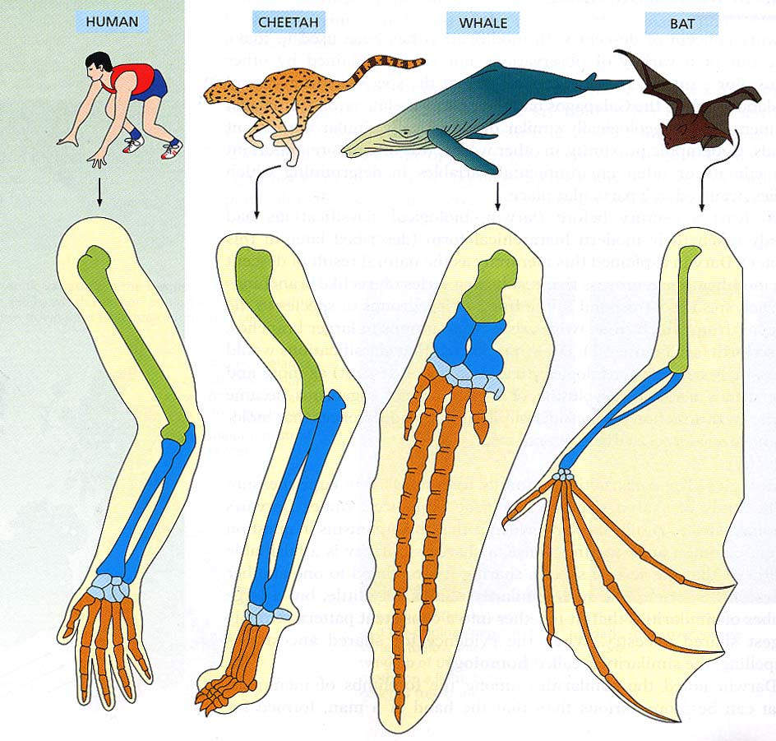
Homologous Structures (BONES in the FORELIMBS) shows Similarities in mammals.

Slide 39
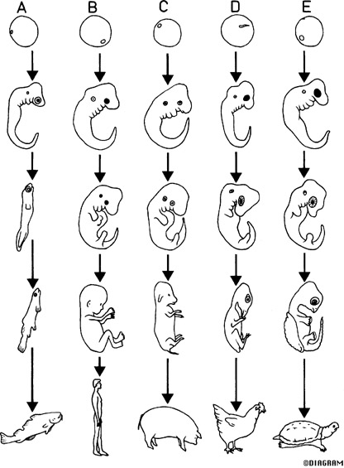
Similarities in Vertebrate Embryos

Slide 40
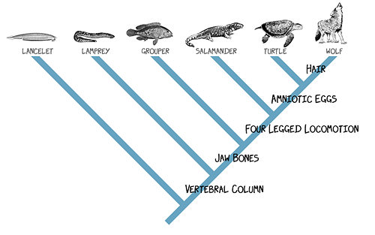
Cladogram
Diagram showing how organisms are related based on shared, derived characteristics such as feathers, hair, or scales

Slide 41
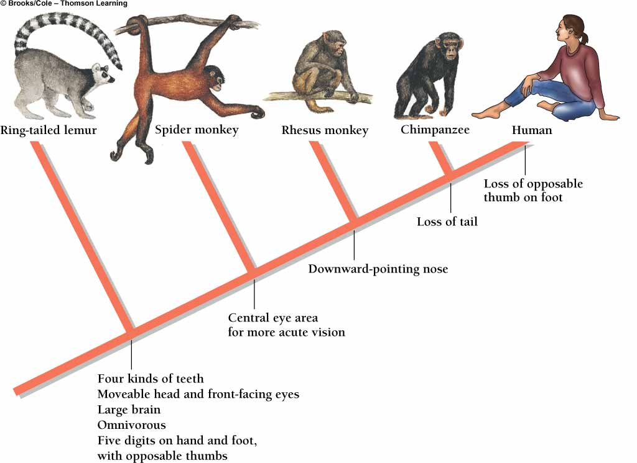
Primate Cladogram

Slide 42
Dichotomous Keying
Used to identify organisms
Characteristics given in pairs
Read both characteristics and either go to another set of characteristics OR identify the organism

Slide 43
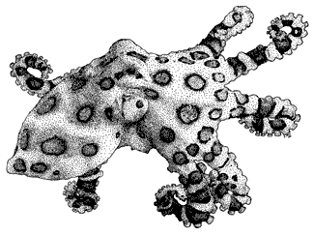

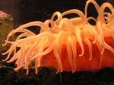
Example of Dichotomous Key
1a Tentacles present – Go to 2
1b Tentacles absent – Go to 3
2a Eight Tentacles – Octopus
2b More than 8 tentacles – 3
3a Tentacles hang down – go to 4
3b Tentacles upright–Sea Anemone
4a Balloon-shaped body–Jellyfish
4b Body NOT balloon-shaped - 5

